Slide 1
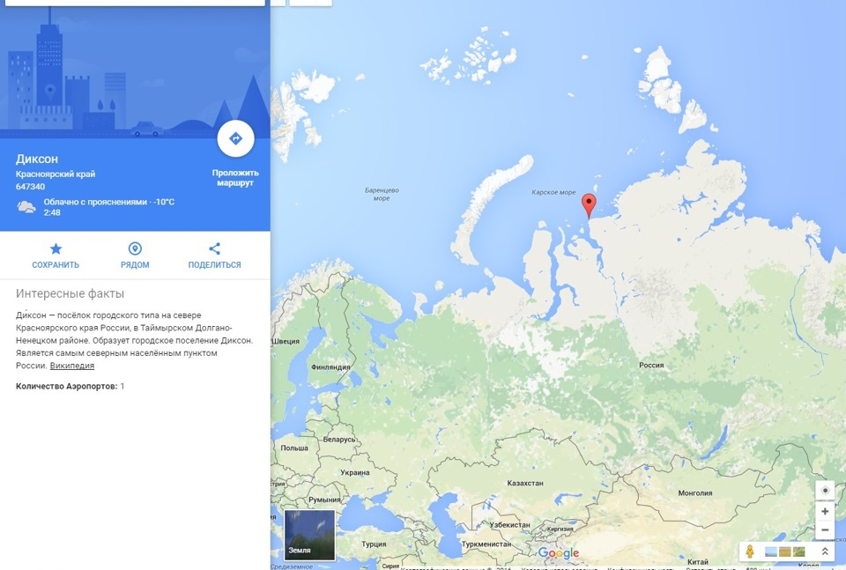
Speaking
Introducing

Slide 2
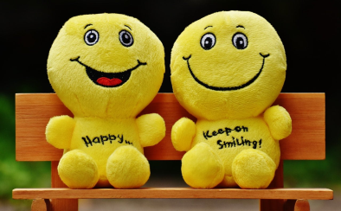
Reading
1. Smile
You smile when you’re happy. We smile because we’re happy, and smiling makes our body release dopamine, which makes us happier. That doesn’t mean you need to go around with a fake smile on your face all the time. But the next time you find yourself feeling bad, crack a smile and see what happens. Or start each morning by smiling at yourself in the mirror.

Slide 3
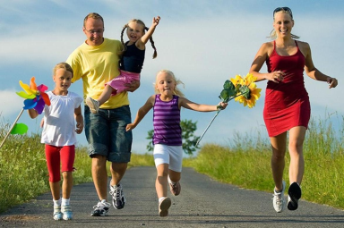
Reading
2. Exercise
Exercise isn’t just for your body. Regular exercise can help to reduce stress and symptoms of depression while boosting happiness. Even a small amount of physical activity can make a difference.

Slide 4
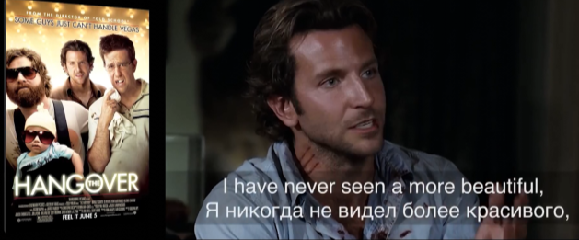
Grammar: Present Perfect
have/has + V3/ed
Настоящее совершенное время – обозначает действие или событие,
которое началось в прошлом (неважно когда)
и завершилось в настоящий момент времени, как факт-результат.

Slide 5
Why do we use Present Perfect?
Result BY NOW
Результат важен к настоящему моменту
Experience
Опыт
(пробовали, делали – имеем знание)
Achievement
Достижение (гордость за выполненное)
Happened in the past,
but the result is important now.
Случившееся в прошлом,
но результат важен сейчас.

Slide 6
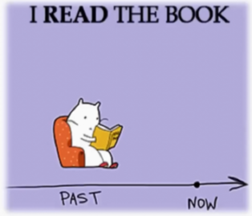
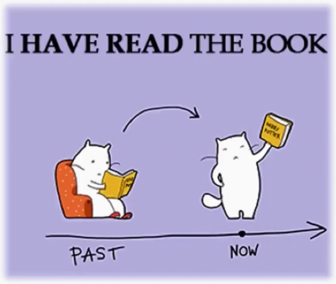
Affirmative sentences
Can you imagine!
This little kitty has already read the book.

Slide 7
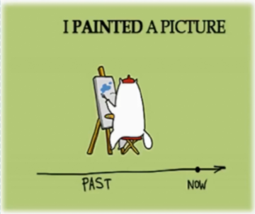
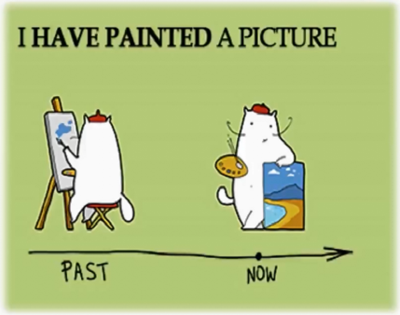
Affirmative sentences
… and the kitten has painted a picture.

Slide 8
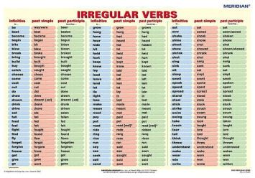
Affirmative sentences
I
you
they
we
We have never seen the snow.
have
She has been to India once.
+ V3/ed
She has already had lunch today.
he
she
it
has
неправильные
правильные
I`ve cooked risotto a few times.

Slide 9
Exercises
Поставь глагол в Present Perfect tense
I already (decide) to study English.
He already (decide) to study English.
We already (decide) to study English.
That`s amazing! She (run) fifteen kilometers this morning!
That`s amazing! I (run) fifteen kilometers this morning!
That`s amazing! You (run) fifteen kilometers this morning!
My brother and she already (see) this film.
They already (see) this film.
He already (see) this film.

Slide 10
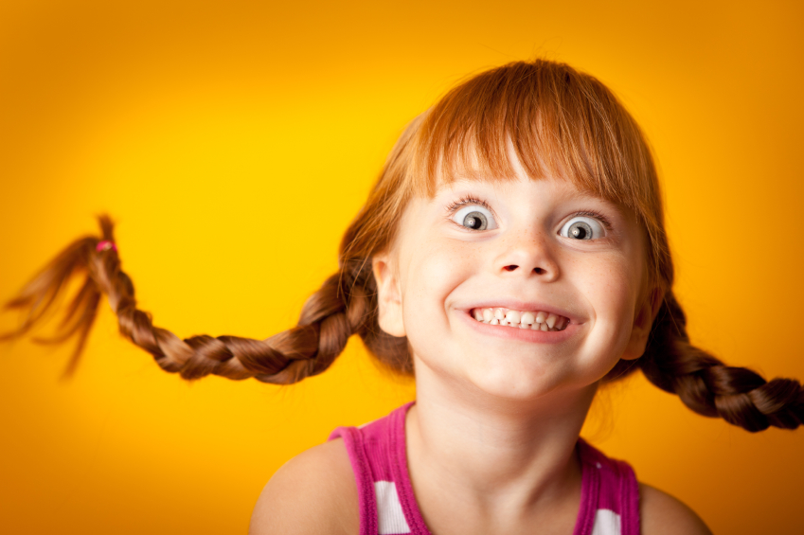
Well done!
See you soon!

