Slide 1
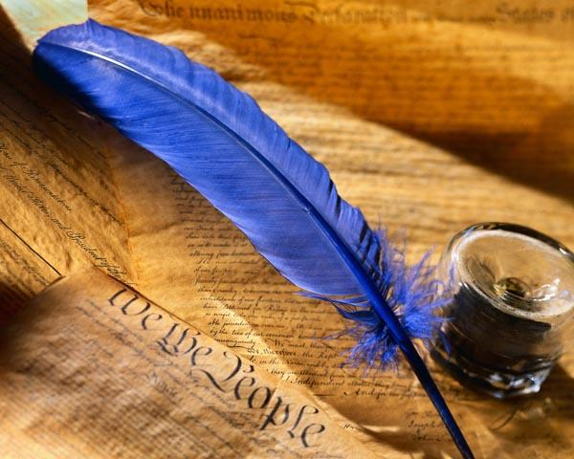
Праздник английской поэзии

Slide 2
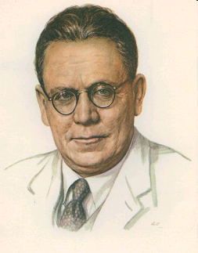
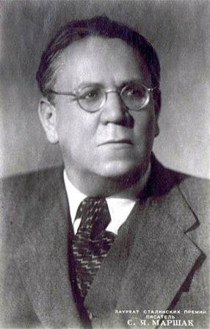
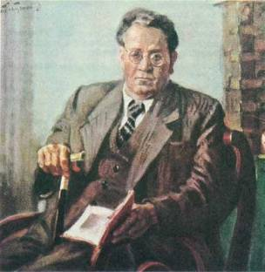
Самуил Яковлевич Маршак
1887-1964

Slide 3
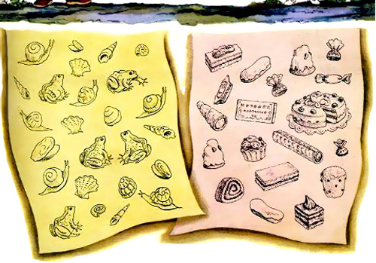

Slide 5
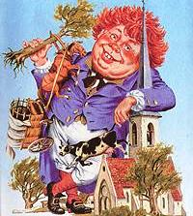

Slide 6
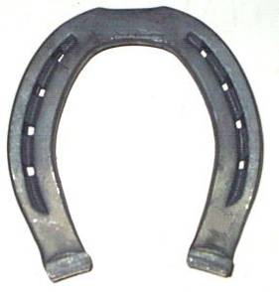
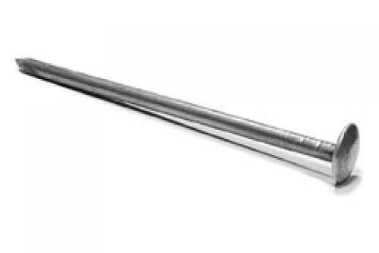

Slide 7
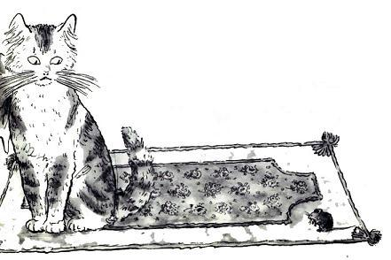

Slide 8
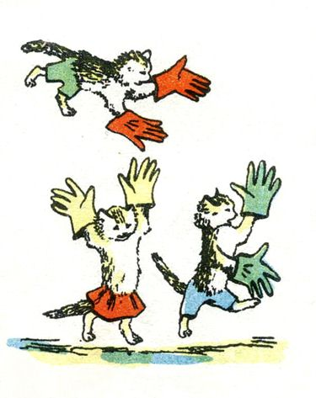
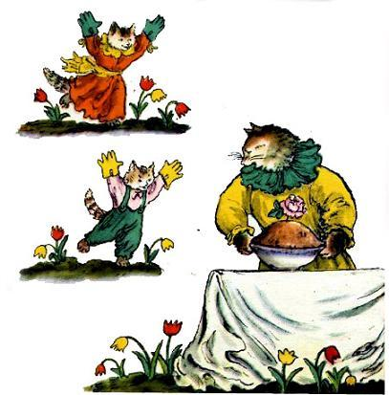

Slide 9
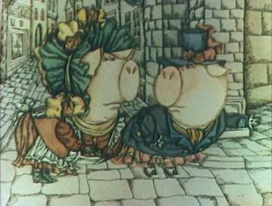
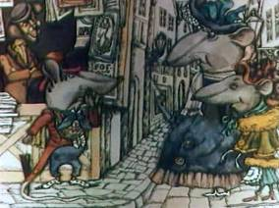
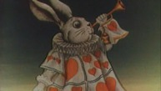
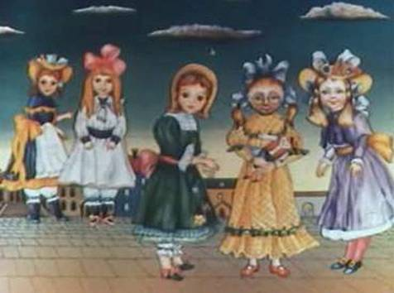
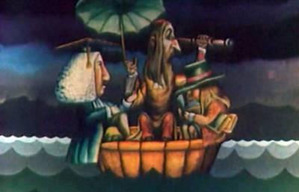

Slide 11
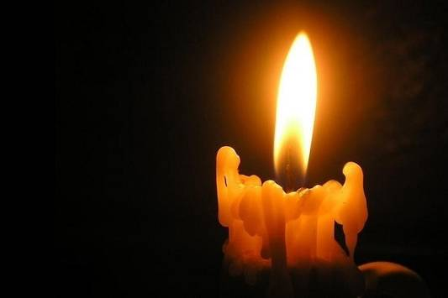
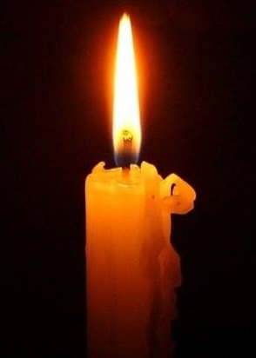

Slide 12
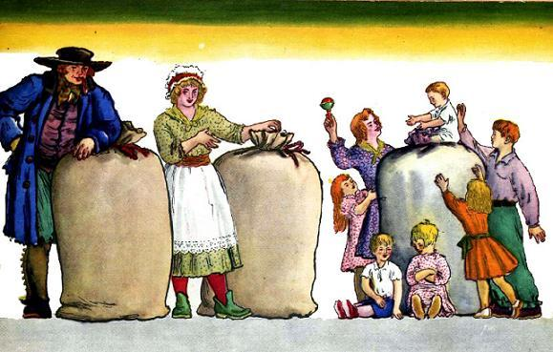
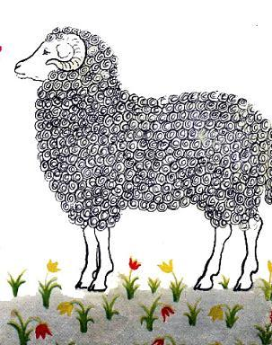

Slide 13
Информационные ресурсы:
http://images.yandex.ru/yandsearch?source=wiz&text=самуил%20маршак%20портрет&noreask=1&pos=14&rpt=simage&lr=13&img_url=http%3A%2F%2F900igr.net%2Fdatai%2Frusskij-jazyk%2FBezudarnye-glasnye-v-korne%2
http://images.yandex.ru/yandsearch?source=wiz&text=%D1%81%D0%B0%D0%BC%D1%83%D0%B8%D0%BB%20%D0%BC%D0%B0%D1%80%D1%88%D0%B0%D0%BA%20%D0%BF%D0%BE%D1%80%D1%82%D1%80%D0%B5%D1%82&noreask=1&pos=8&rpt=simage&lr=13&img_url=http%3A%2F%2Fdic.academic.ru%2Fpreview%2F20377938%2Fmarshak.jpg
http://images.yandex.ru/yandsearch?source=wiz&text=%D1%81%D0%B0%D0%BC%D1%83%D0%B8%D0%BB%20%D0%BC%D0%B0%D1%80%D1%88%D0%B0%D0%BA%20%D0%BF%D0%BE%D1%80%D1%82%D1%80%D0%B5%D1%82&noreask=1&pos=21&rpt=simage&lr=13&img_url=http%3A%2F%2Fwww.kostyor.ru%2Fimages0%2Fbiogr%2Fmarshak.jpg
http://images.yandex.ru/yandsearch?source=wiz&text=%D1%88%D0%B0%D0%BB%D1%82%D0%B0%D0%B9-%D0%B1%D0%BE%D0%BB%D1%82%D0%B0%D0%B9&noreask=1&pos=1&rpt=simage&lr=13&img_url=http%3A%2F%2Fwww.forexpf.ru%2Fupload%2F326838_1.gif
http://images.yandex.ru/yandsearch?source=psearch&p=2&text=%D0%B3%D0%B2%D0%BE%D0%B7%D0%B4%D1%8C%20%D0%B8%20%D0%BF%D0%BE%D0%B4%D0%BA%D0%BE%D0%B2%D0%B0&noreask=1&pos=62&lr=13&rpt=simage&img_url=http%3A%2F%2Fkazan.fis.ru%2Fminiformat%2F10088203.jpg
http://images.yandex.ru/yandsearch?source=psearch&p=3&text=%D0%B3%D0%B2%D0%BE%D0%B7%D0%B4%D1%8C%20%D0%B8%20%D0%BF%D0%BE%D0%B4%D0%BA%D0%BE%D0%B2%D0%B0&noreask=1&pos=98&lr=13&rpt=simage&img_url=http%3A%2F%2Fdostavka.privatesales.ru%2Fupload%2Fshop_1%2F2%2F2%2F5%2Fitem_225688%2Fsmall_shop_items_catalog_image225688.jpg
http://images.yandex.ru/yandsearch?text=%D0%B2%20%D0%B3%D0%BE%D1%81%D1%82%D1%8F%D1%85%20%D1%83%20%D0%BA%D0%BE%D1%80%D0%BE%D0%BB%D0%B5%D0%B2%D1%8B%20%D0%BC%D0%B0%D1%80%D1%88%D0%B0%D0%BA&pos=1&rpt=simage&img_url=http%3A%2F%2Fwww.planetaskazok.ru%2Fimages%2Fstories%2Fmarshak%2Fangliyskie_pesenki%2F44.jpg
http://images.yandex.ru/yandsearch?source=psearch&text=%D0%BF%D0%B5%D1%80%D1%87%D0%B0%D1%82%D0%BA%D0%B8%20%D0%BC%D0%B0%D1%80%D1%88%D0%B0%D0%BA&noreask=1&pos=3&rpt=simage&lr=13&img_url=http%3A%2F%2Fs-marshak.ru%2Fbooks%2Fp%2Fp01%2Fp01_05.jpg
http://images.yandex.ru/yandsearch?source=psearch&text=%D0%BF%D0%B5%D1%80%D1%87%D0%B0%D1%82%D0%BA%D0%B8%20%D0%BC%D0%B0%D1%80%D1%88%D0%B0%D0%BA&noreask=1&pos=6&rpt=simage&lr=13&img_url=http%3A%2F%2Fwww.planetaskazok.ru%2Fimages%2Fstories%2Fmarshak%2Fangliyskie_pesenki%2F16.jpg
http://images.yandex.ru/yandsearch?p=7&text=%D1%81%D0%B2%D0%B5%D1%87%D0%B0&pos=218&rpt=simage&img_url=http%3A%2F%2Fkp.ru%2Ff%2F12%2Fimage%2F87%2F98%2F3289887.jpg

